Slide 1

the
workshop

Slide 2
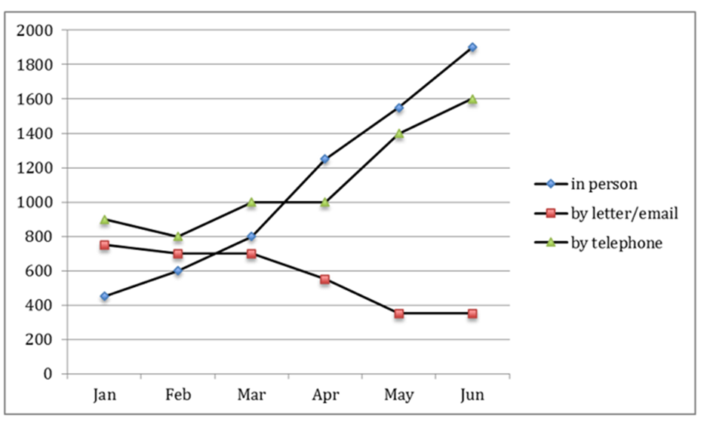
Question: The graph below shows the number of enquiries received by the Tourist Information Office
in one city over a six-month period in 2011
Notes:
Measurements:
the number of / the quantity of questions was
… questions were sent to…/visitors sent …
(last resource) the number/data/figure for …
(no) the amount/percentage/rate of
2. Approach: group details in body paragraphs
[B1]: in person & telephones
Câu 1 & 2: Static sentence (January) & compare
Câu 3 & 4: Trend – từng loại***
[B2]: letter/emai
Câu 1&2: Trend+ cohesive devices***
3. Paraphrase:
In person
Direct (face-to-face) communication | … meetings
Letter/email
Mailing | Mailed (written) questions/ enquiries/ queries.

